Slide 1


OPIM 5671 : DATA MINING AND BUSINESS INTELLIGENCE
FORECASTING SALES USING STORE, PROMOTION, AND COMPETITOR DATA
Team #8
QIUYI JIA
KUNJA DUTTA
SUSHANT GANDHI
RIKDEV BHATTACHARYA
27th April 2017

Slide 2

BUSINESS OBJECTIVES
COMPLICATIONS/GAPS
Missing data for 181 Stores
1 Million+ rows of data
Diverse market
Finding the right model for each store
CURRENT STATE
DESIRED FUTURE STATE
Store Managers predicting sales with logic & intuition
Store and Customer Information, Promotion Details, Competitor Data, School and State Holidays, Seasonality factors not taken into consideration
Gap in Demand and Supply
Create robust Forecasting Models to predict Sales
Optimize the information from the dataset
Reduce operational loss/ wastage
QUESTIONS
How to forecast sales for the next 2 Months?
How to customize models for each store?
How to use regressors to improve accuracy?
How do we handle the data size?

Slide 3
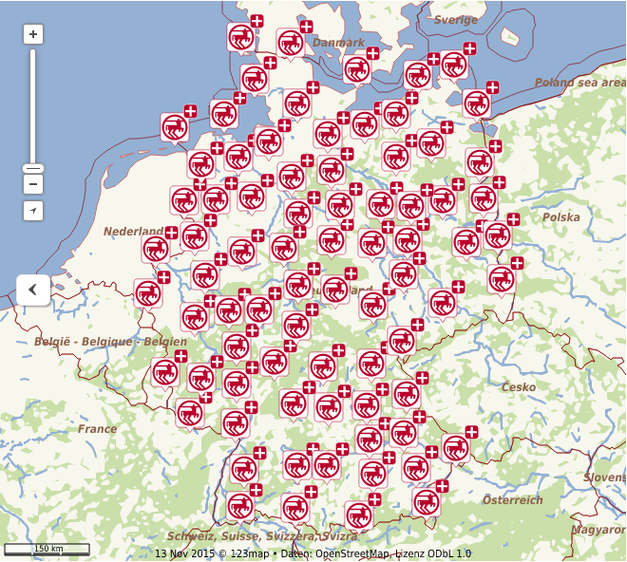
ABOUT ROSSMAN
2nd
Largest
Drug Store chain
In Germany
3000+
Retail Stores
33
Present in European and Asian Countries

Slide 4


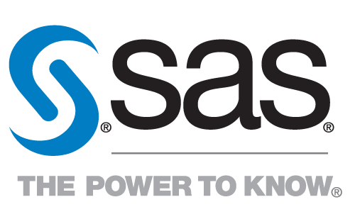


DATASET
Dataset Features
Predict
For
2
1115
Store and Customer Information
Promotion Details
Competitor Data
School and State Holidays
Seasonality
Month of Sales
1st Aug to 30th Sep’15
Stores
across Germany

Slide 5
APPROACH
DATA EXPLORATION
PATTERN DISCOVERY AND CLUSTERING
4 CLUSTERS
TIME SERIES
FORECASTING
KEY FINDINGS AND BUSINESS RECOMMENDATION
TRAIN SET
(.CSV)
STORES SET
(.CSV)
STORES WITH NON MISSING DATA
(934 STORES)
DATA MANIPULATION
COMBINED
DATASET
(.CSV)
STORES WITH MISSING DATA
(181 STORES)
REMOVE

Slide 6
DATA MANIPULATION
Step 1
Merging train.csv and store.csv datasets based on Store Id#
Step 2
Transforming Daily Sales Data into Monthly Sales Data using Pivot in Excel
Step 3
Analyzing Data and removing stores with missing values
Step 6
Step 5
Step 4
Transforming Variables
K-means Clustering in R
Combining monthly data for each Cluster

Slide 7
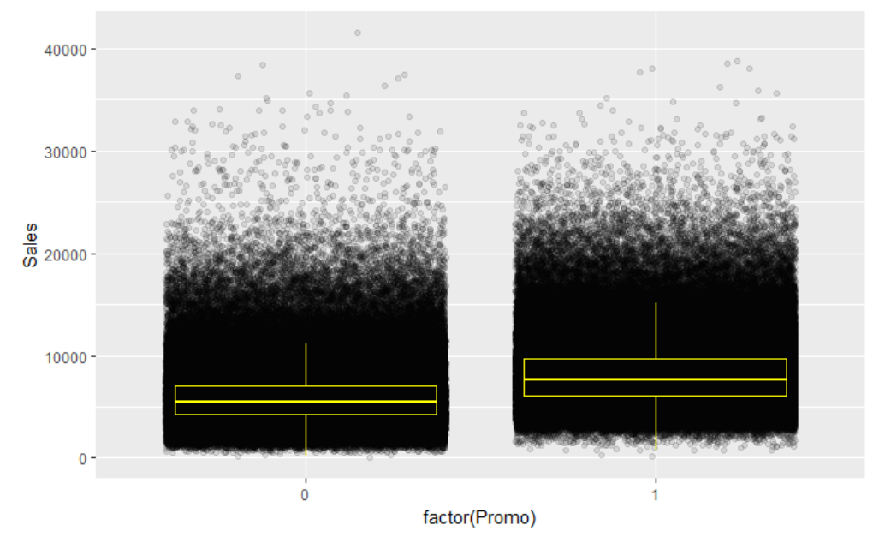
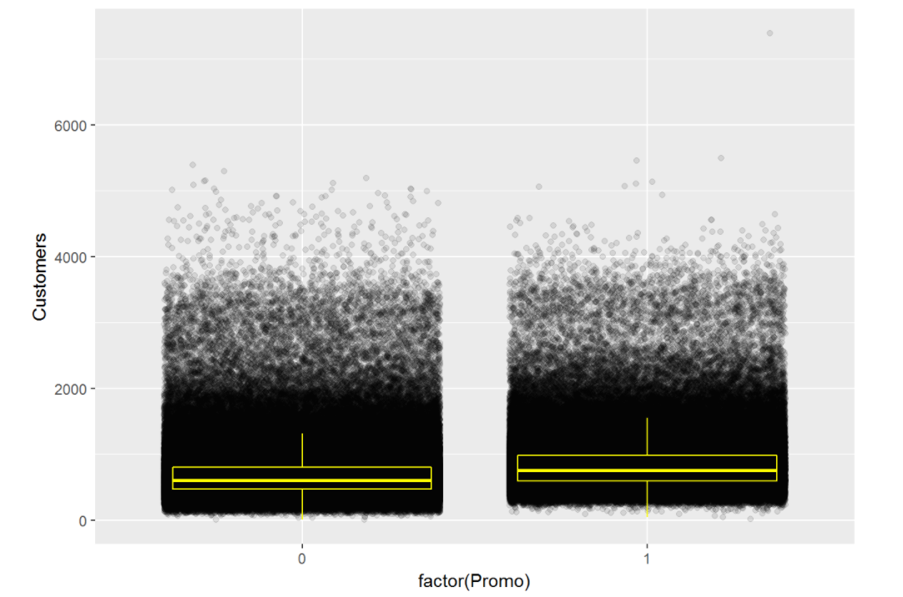
DATA EXPLORATION
How Promos affects Sales & Customers?
Notes:
From the plots, we can see that sales is as expected strongly correlated with the number of customers. With promos, amount of sales and customers both increased. But it looks like the Boxplots of customers overlap a little more than the boxplots of sales, that means the promos are not mainly attracting more customers but make customers spend more.

Slide 8
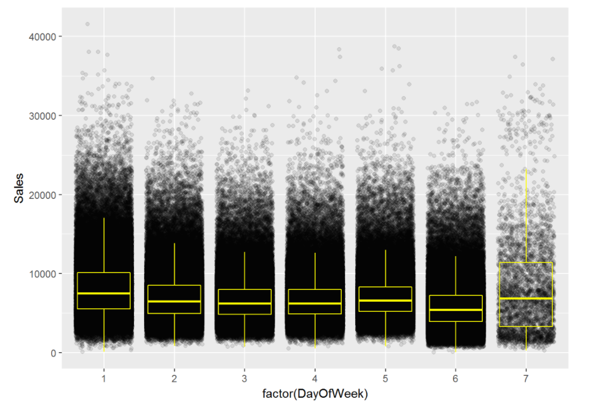
DATA EXPLORATION
Variability of Sales by Day of the Week
Notes:
We see quite high variability of sales on Sundays when the stores are open.

Slide 9
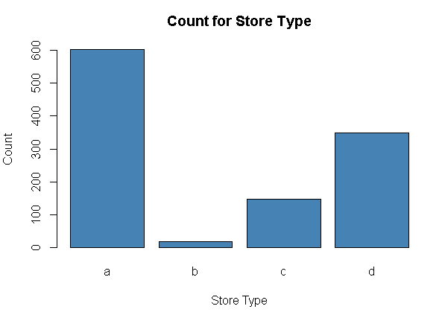
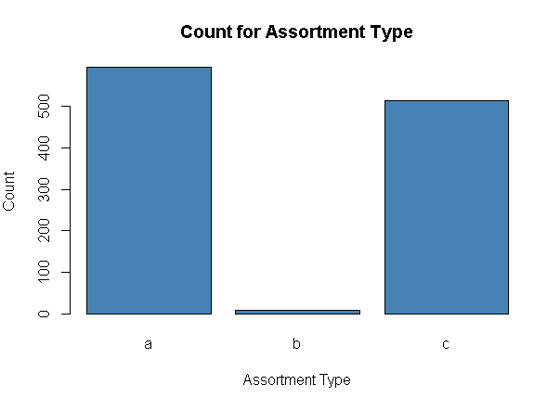
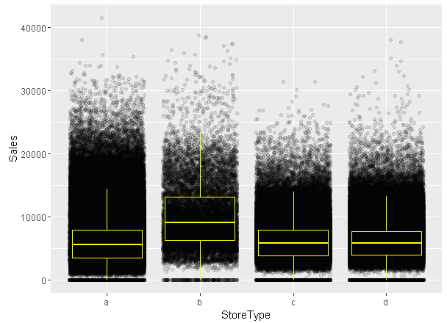
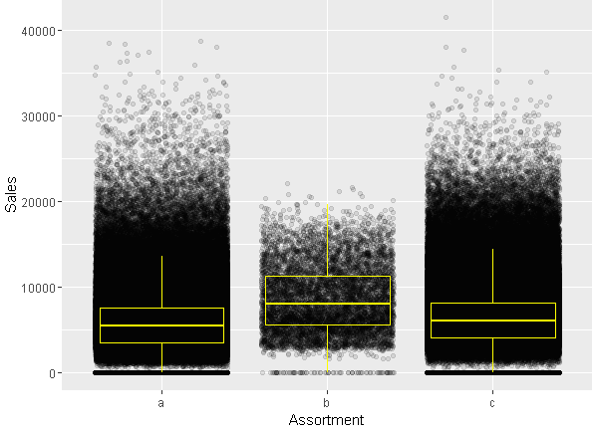
DATA EXPLORATION
How does Sales vary with Store and Assortment Type?
Notes:
Surprisingly, store type b and assortment type b have lowest numbers among all types, however, their total sales vary even more than others.

Slide 10
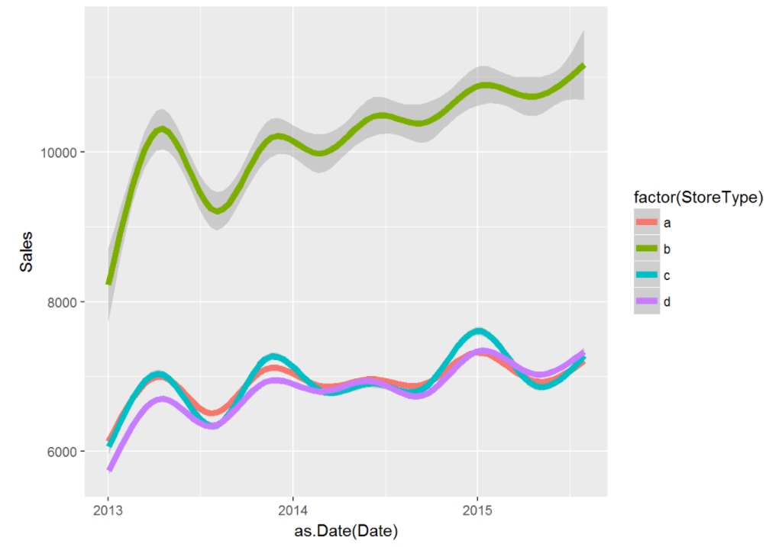
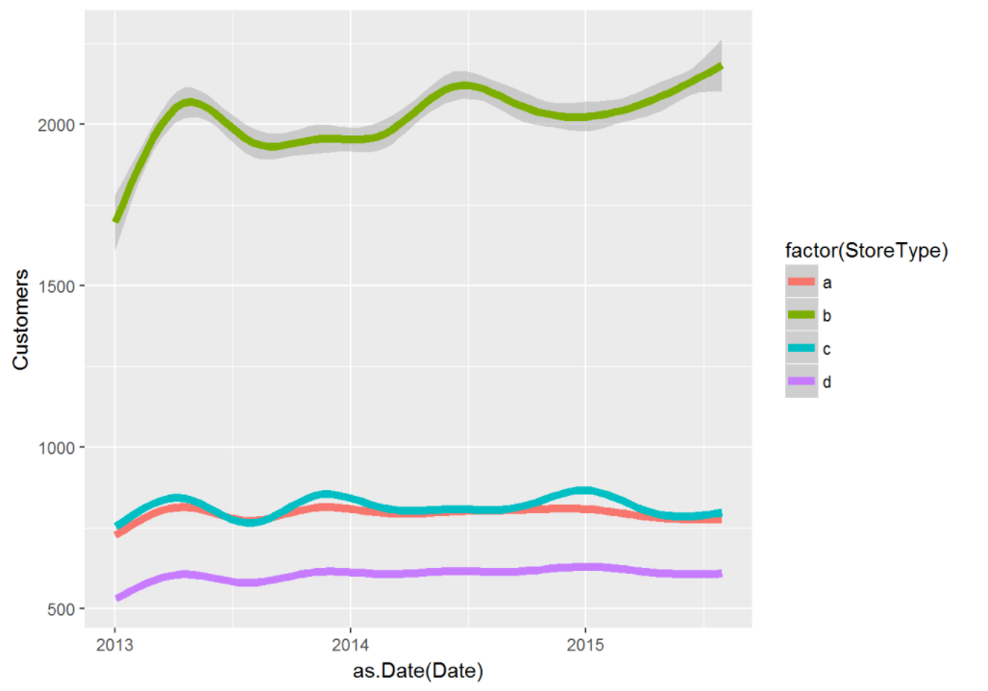
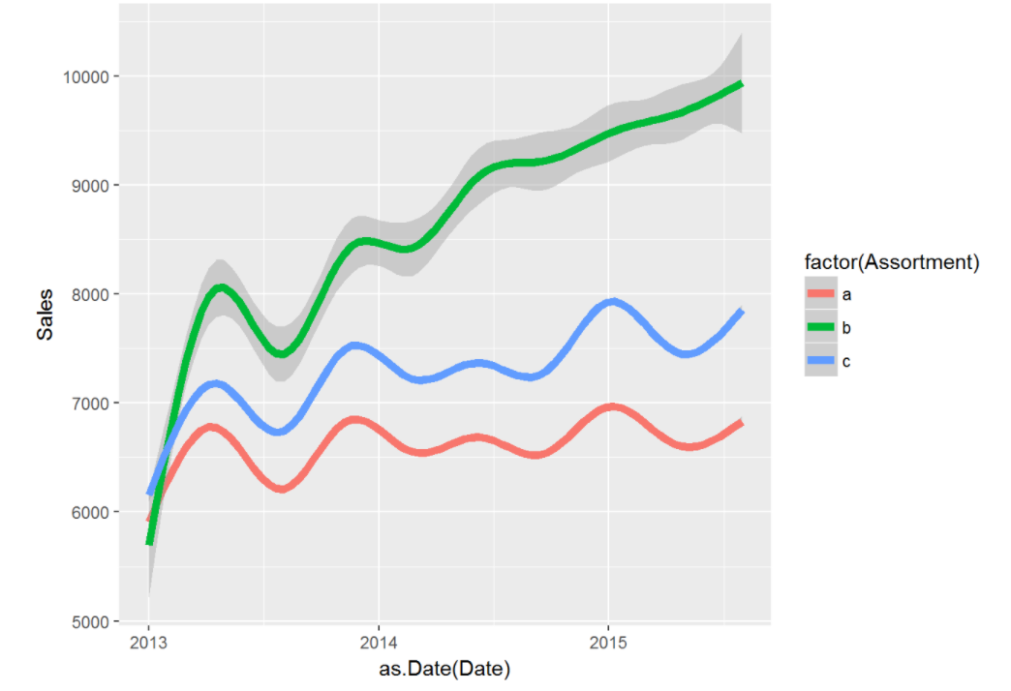
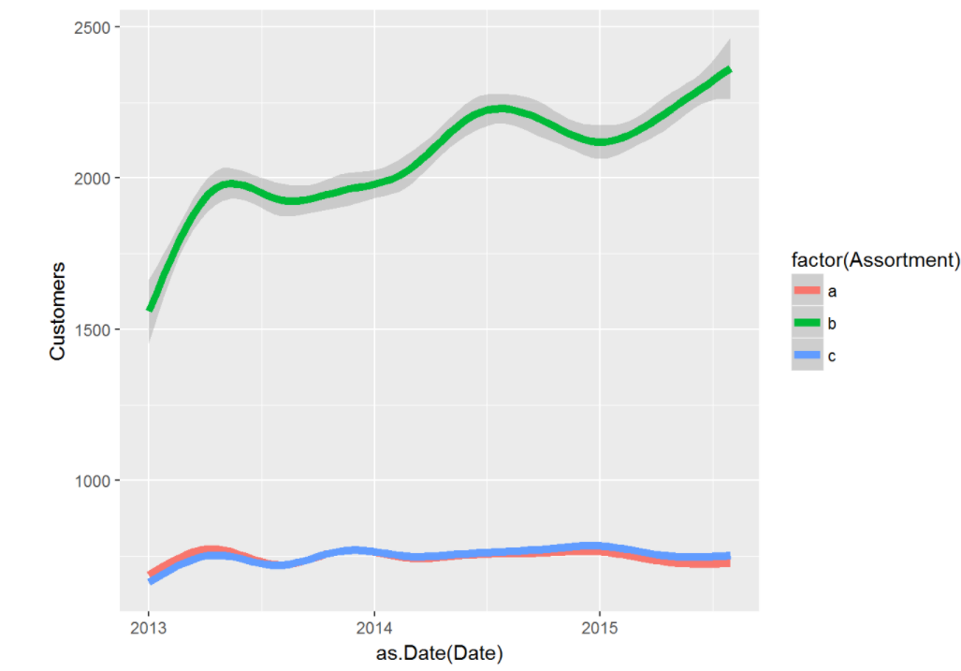
DATA EXPLORATION
Impact of store and assortment types on Sales

Slide 11
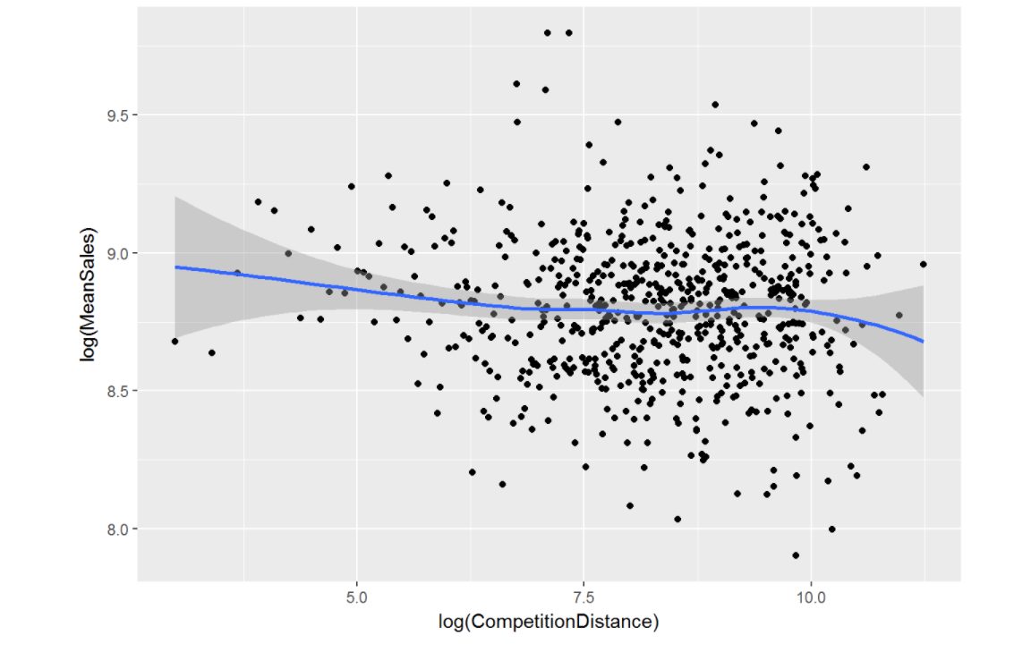
DATA EXPLORATION
Effect of Competitor Distance on Mean Sales
Notes:
Lower distance to the next competitor implies (slightly, possibly not significantly) higher sales. This may occur (my assumption) because stores with a low distance to the next competitor are located in inner cities or crowded regions with higher sales in general.

Slide 12
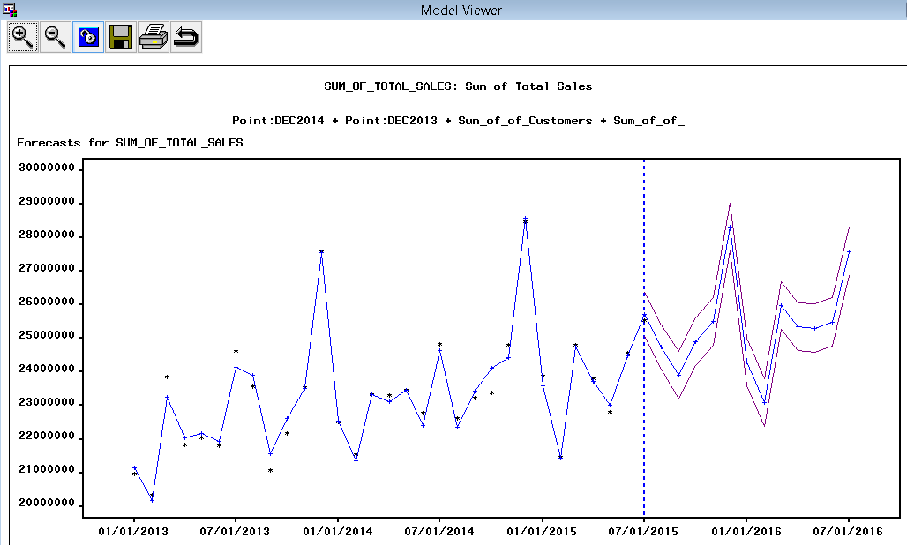
DATA MODELING AND FORECASTING
Cluster 1
Average Monthly Sales = $23,368,651
Number of Stores = 137
Model = AR(2) + Quadratic Trend + Intervention : point(Dec 2013) + Intervention : point(Dec 2014) + Regressor (Sum of Customers) + Regressor (Sum of School Holidays)

Slide 13
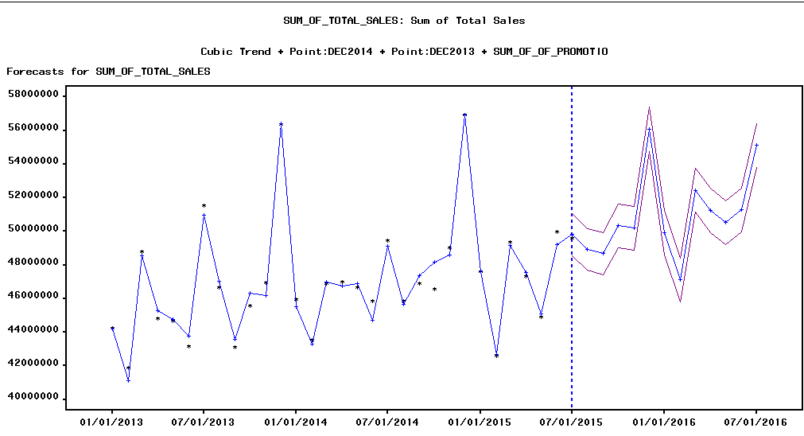
DATA MODELING AND FORECASTING
Cluster 2
Average Monthly Sales = $27,081,813
Number of Stores = 295
Model = AR(2) + Cubic Trend + Intervention : point(Dec 2013) + Intervention : point(Dec 2014) + Regressor (Sum of Customers) + Regressor (Sum of Promotion Days)

Slide 14
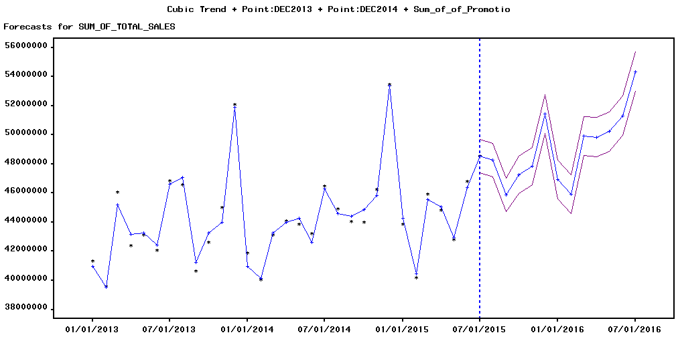
DATA MODELING AND FORECASTING
Cluster 3
Average Monthly Sales = $44,411,689
Number of Stores = 210
Model = AR(2) + Cubic Trend + Intervention : point(Dec 2013) + Intervention : point(Dec 2014) + Regressor (Sum of Customers) + Regressor (Sum of Promotion Days)

Slide 15
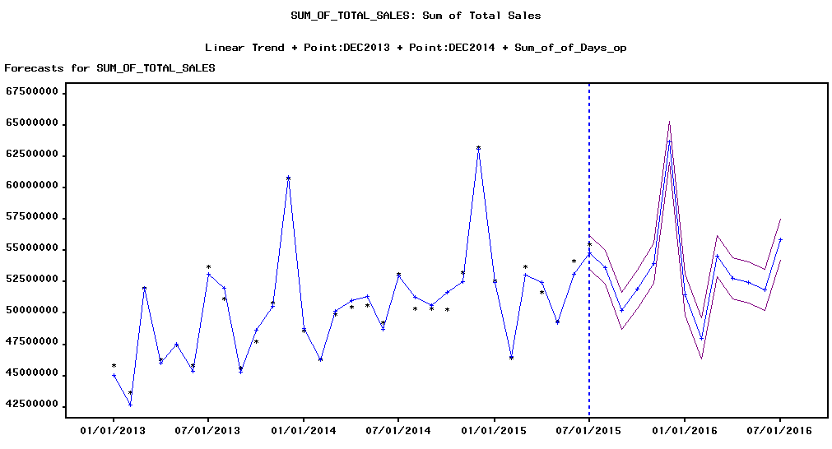
DATA MODELING AND FORECASTING
Cluster 4
Average Monthly Sales = $50,647,950
Number of Stores = 297
Model = AR(2) + Linear Trend + Intervention : point(Dec 2013) + Intervention : point(Dec 2014) + Regressor (Sum of Customers) + Regressor (Sum of Days Open)

Slide 16
DATA MODELING AND FORECASTING
Cluster 1 Trend: Yes, Seasonality: No, Interventions: Dec 2013, Dec 2014, Regressors: Sum of customers and Sum of School Holidays | Cluster 2 Trend: Yes, Seasonality: No, Interventions: Dec 2013, Dec 2014, Regressors: Sum of promotion days and Sum of customers
Cluster 3 Trend: Yes, Seasonality: No, Interventions: Dec 2013, Dec 2014, Regressors: Sum of promotion days and Sum of customers | Cluster 4 Trend: Yes, Seasonality: No, Interventions: Dec 2013, Dec 2014, Regressors: Sum of days open and Sum of customers
Notes:
Average sales, no of stores, which cluster gets priority, rmse of forecasting, accuracy of clusters,

Slide 17
FORECAST SUMMARY
# | # of Stores | Average Monthly Sales | Model RMSE | Accuracy Rank | Variations in forecast boundaries | Best Model
Cluster 1 | 137 | $23,368,651 | 283528 | 1 | 2.65% | AR(2) + Quadratic Trend + Intervention : point (Dec 2013)+Intervention:point(Dec 2014)+Regressor (Sum of Customers) + Regressor (Sum of School Holidays)
Cluster 2 | 295 | $27,081,813 | 526390 | 3 | 2.66% | AR(2) + Cubic Trend + Intervention : point (Dec 2013)+Intervention:point(Dec 2014)+Regressor (Sum of Customers) + Regressor (Sum of Promotion Days)
Cluster 3 | 210 | $44,411,689 | 478732 | 2 | 1.96% | AR(2) + Cubic Trend + Intervention : point (Dec 2013)+Intervention:point(Dec 2014)+Regressor (Sum of Customers) + Regressor (Sum of Promotion Day)
Cluster 4 | 297 | $50,647,950 | 603921 | 4 | 3.12% | AR(2) + Linear Trend + Intervention : point (Dec 2013)+Intervention:point(Dec 2014)+Regressor (Sum of Customers) + Regressor (Sum of Days Open)

Slide 18
KEY FINDINGS AND RECOMENDATION
Key Finding | Recommendation
1. Events around December are uniform across all clusters | 1. Stock up in advance
2. Promotion days play an important role | 2. Innovative offers should be ran from time to time
3. Cluster 3 generates good sales, modeling provides less error and boundary variations of forecast are less | 3. More stores similar to characteristics of cluster 3 should be set up
4. Store type b and Assortment type b have higher sales | 4. Continue focus on these Store and Assortment types and increase marketing efforts to maximize sales.

Slide 19


